Slide 1
Predicting AIDS Progression with Data Insights
Rahul Gade

Slide 2
Table of Content
Project Overview
Data Cleaning
Visualizations
Data Examination
Machine Learning
Recommendations

Slide 3

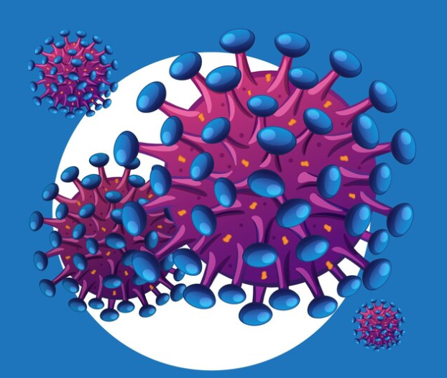
Project Overview
Objective
A machine learning model capable of accurately predicting HIV progression to AIDS.

Slide 4
Dataset
Source: Kaggle - AIDS Clinical Trials Group
Task: to predict whether or not each patient is infected with AIDS at end of the trial
Target: infected - yes/no - a binary classification problem
Features: current treatments, previous treatments, CD4/CD8 cell count at baseline and after 20 weeks (immunity measure), symptomatic, sex, age, weight, race, history of drug use, etc.

Slide 5



Data Cleaning
Extract, transform, and load (ETL)
Data cleaning
Connection to SQL Database

Slide 6
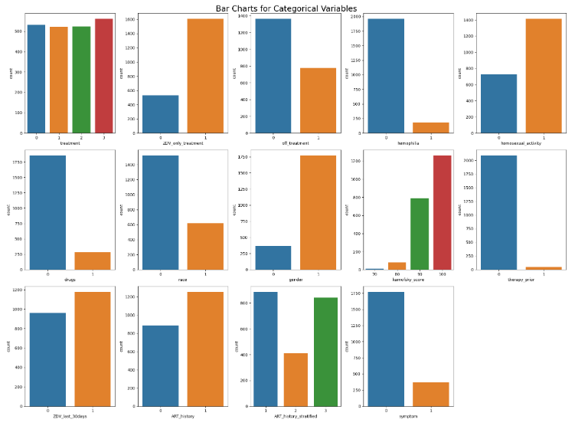
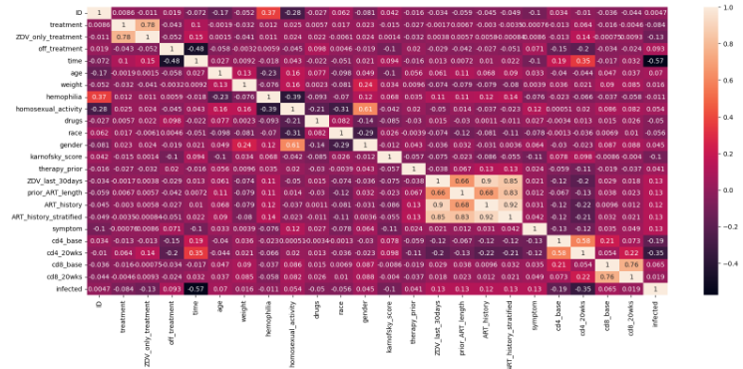
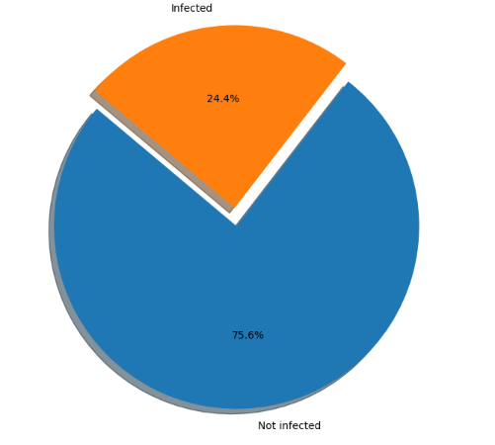
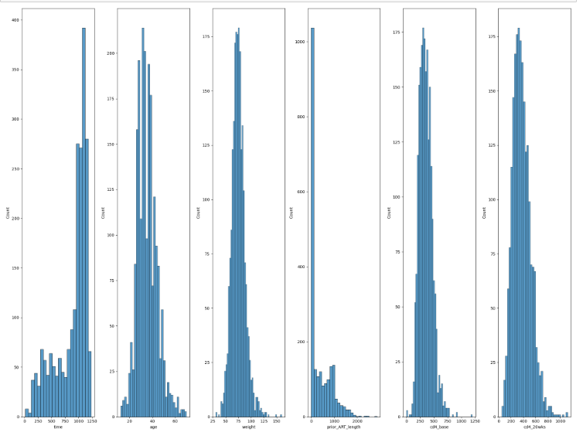
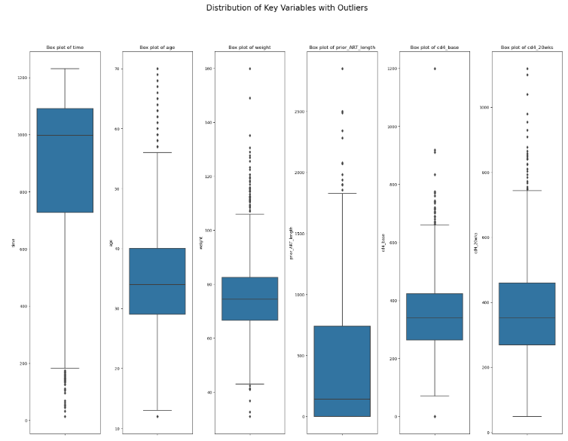
Visualisations
Data Insights
Infected vs Not infected Distribution
Categorical and Numerical Variables
Correlation matrix and Variable Outliers

Slide 7
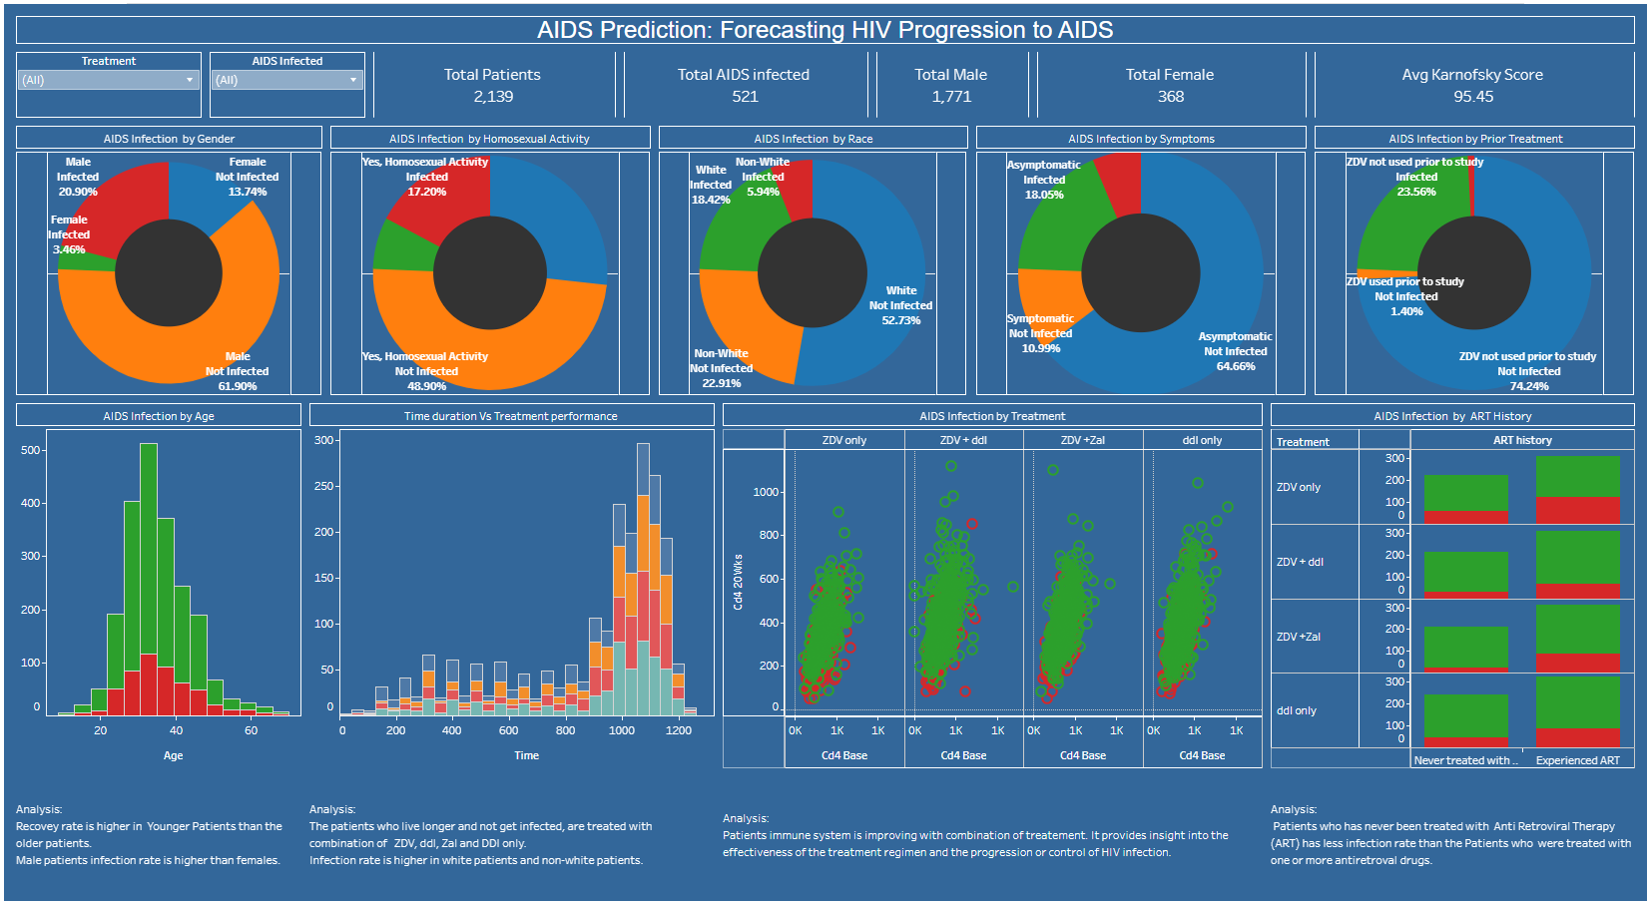
Visualisations
Data Insights
Variables affecting AIDS infection Rate

Slide 8
Handling class Imbalance
SMOTE (Synthetic Minority Over-sampling Technique)
Algorithmic techniques: class weight parameter to “balance” e.g. Logistic Regression, SVM(Support Vector Machine)
Machine Learning Model selection like Random Forest
Evaluation Metrics. i.e. precision, and recall

Slide 9
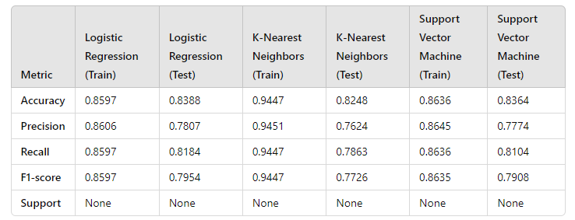
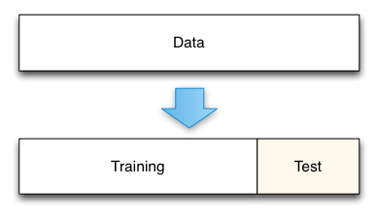
Machine Learning Models
KNN, SVM and Logistic Regression
Methodology
Train-Test Split:
Split the dataset into 80% training and 20% testing using ‘train_test_split’ with stratification to maintain the class distribution.

Slide 10
Machine Learning Models
KNN, SVM and Logistic Regression
Consistent accuracy across models - approx. 82% to 84%
Logistic Regression and SVM performed similarly, with Logistic Regression having a slightly better balance between precision and recall for the test set.
KNN had the highest training accuracy, but slightly lower test accuracy compared to Logistic Regression and SVM, indicating potential overfitting.
Logistic Regression showed the highest F1-score for the infected class on the test set, which may be crucial depending on the importance of minimizing false negatives or positives.
Overall, Logistic Regression and SVM appear to be more reliable, with Logistic Regression having a slight edge in handling imbalanced data better.

Slide 11
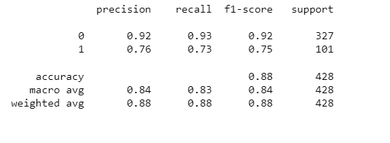
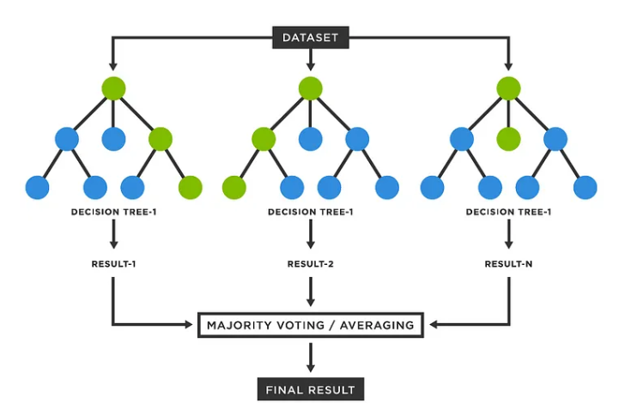
Machine Learning Models
Random Forest
Image source: https://medium.com/@denizgunay/random-forest-af5bde5d7e1e

Slide 12
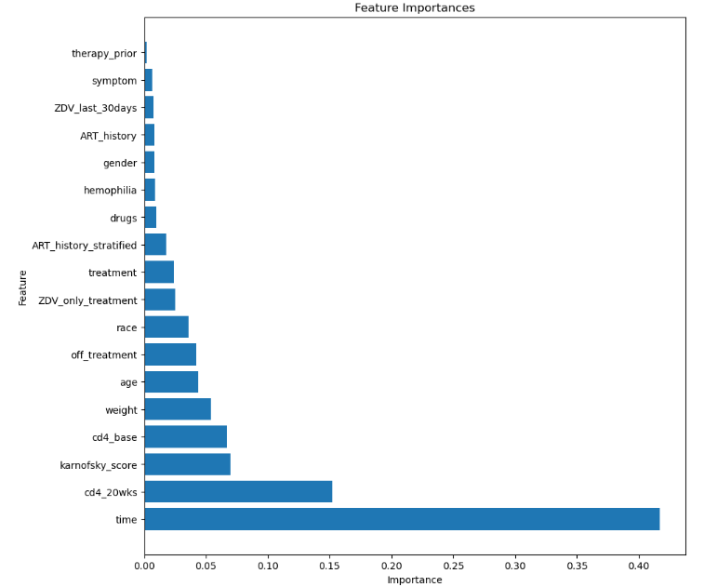
Machine Learning Models
Random Forest
Extracts feature importances from the trained Random Forest model.

Slide 13
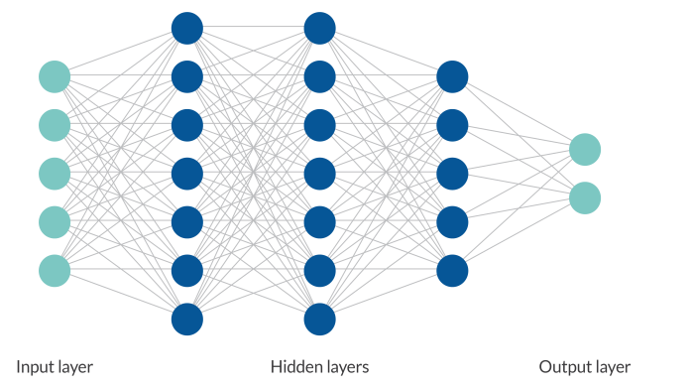
Deep Neural Network (DNN)

Slide 14
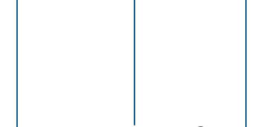
Deep Neural Network (DNN)
DNN Model (Attempt 1)
optimizer='adam'
epochs=50
Measured metrics:
acc train: 100%
acc test: 87%
precision: 74%
recall: 73%
Model is over fitted
80 neuron 30 neuron 1 neuron
Relu Relu Sigmoid

Slide 15
Deep Neural Network (DNN)
DNN Model (Attempt 2)
optimizer='adam'
epochs=100
Measured metrics:
acc train: 96%
acc test: 86%
precision: 71%
recall: 76%
Model is less overfitted
3% increase in recall
14 neuron 7 neuron 1 neuron
Relu Relu Sigmoid

Slide 16
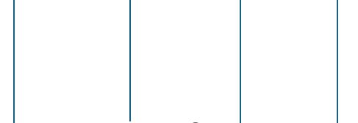
Deep Neural Network (DNN)
DNN Model (Attempt 3)
The structure optimised using the Keras Tuner
optimizer='adam'
epochs=25
Measured metrics:
acc train: 96%
acc test: 88%
precision: 73%
recall: 81%
Model is less overfitted
5% increase in recall
30 neuron 12 neuron 24 neuron 1 neuron
Relu Relu Relu Sigmoid

Slide 17
Deep Neural Network (DNN)
DNN Model (Attempt 4)
The structure optimised using the Keras Tuner
We just kept 7 first important features offered by Random Forest model.
optimizer='adam'
epochs=25
Measured metrics:
acc train: 95%
acc test: 89%
precision: 79%
recall: 81%
Model was not over fitted
This was the best model with highest accuracy, precision, and recall
30 neuron 12 neuron 24 neuron 1 neuron
Relu Relu Relu Sigmoid

Slide 18
Evaluation of Models
Logistic Regression
K-Nearest Neighbours
SVM
Random Forest
Deep Neural Network
Test Accuracy
Precision
Recall

Slide 19
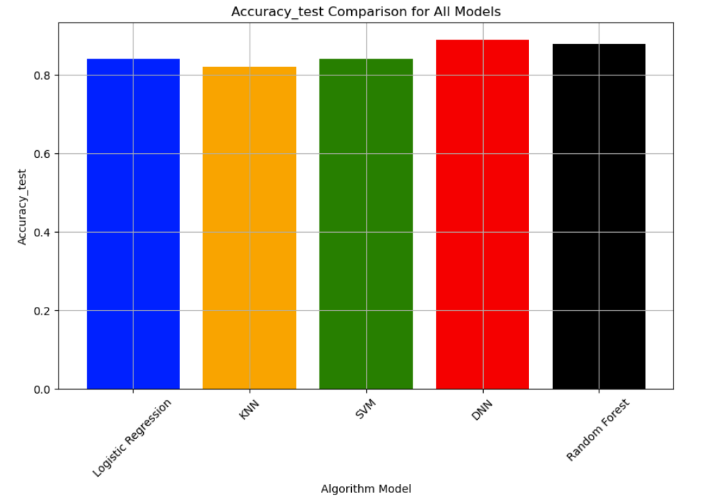
Statistical Metrics Comparison - Test Accuracy

Slide 20
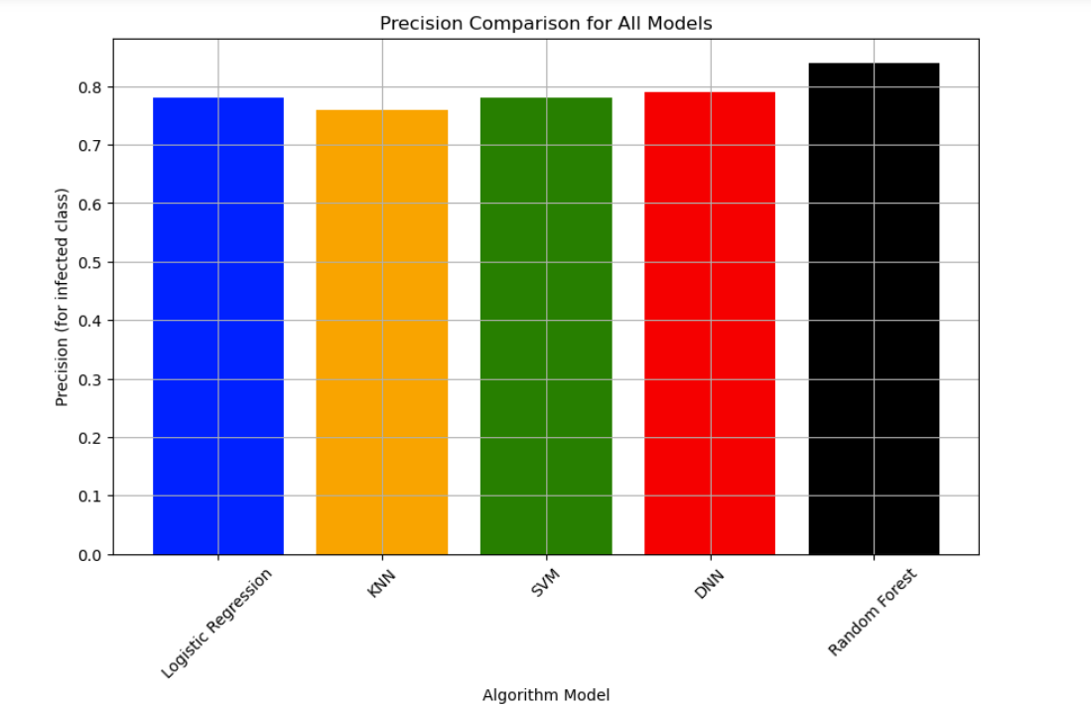
Statistical Metrics Comparison - Precision

Slide 21
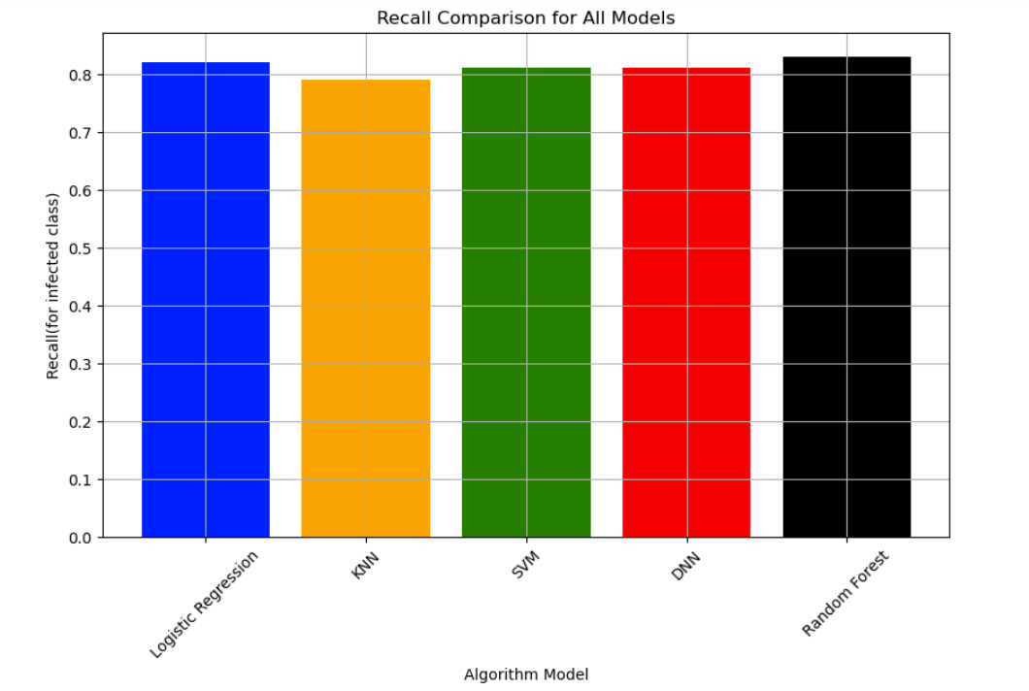
Statistical Metrics Comparison - Recall

Slide 22
Predictive Machine Learning Models Discussion
Overall Conclusion:
Based on the evaluation metrics:
Random Forest: This model has strong performance across all metrics, particularly in test accuracy (0.88), precision (macro avg: 0.84), recall (macro avg: 0.83), and F1-score (macro avg: 0.84).
Neural Network: This model also performs very well, with the highest accuracy (0.89) and strong precision (0.79) and recall (0.81).
Recommendation:
The Random Forest model is the best choice overall because it offers a good balance of accuracy, precision, recall, and F1-score, making it highly reliable for predicting both infected and not infected cases. The Neural Network is a close second and might be preferable in scenarios where slightly higher accuracy is crucial.

Slide 23
Any Questions?

Slide 24




Thank you
Rahul Gade
rahulmg2002@yahoo.com
+614032732966
https://github.com/RahulG2381
linkedin.com/in/rahul-gade-b9514119

